Slide 1




Slide 2
Open Governments – Open Societies?
Datathon, Driving Democracy with Data in Central and Eastern Europe
Sarah Klein, Michał Miłkowski
21.04.2018
Notes:
Several alternative title slide layouts are available toward the end of this template deck.

Slide 3
Agenda
Determinants of civil society
Civil society oriented relations between CEE countries
Is civil society related to health?

Slide 4

Civil Society Participation

Slide 5
First notes
Aim: Explore determinants of civil society
Scale: CEE countries
Dependent variable: civil society participation
Independent variables: from the world bank and civil society data sources (around 400)
Use of Python and R

Slide 6
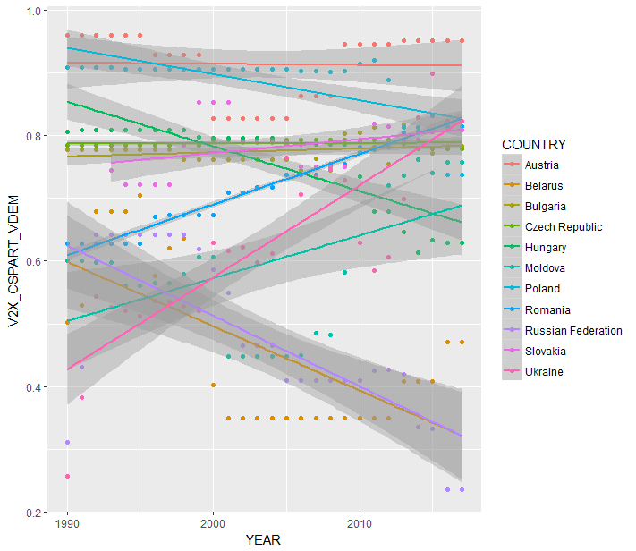
Overview of civil society participation in CEE

Slide 7
Top 10 positively correlated variables (Ukraine)
CSO participatory environment *
Forest area (% land area)
CSO Consultation *
Women political participation index *
Religious organization consultation
Sustainable energy for all
State ownership of economy
Jobs (mobile cellular subscriptions (per 100 people))
Renewable electricity output (% of total electricity output)
Tertiary school enrollment
* Excluded from final model due to being part of the final index

Slide 8
Top 10 negatively correlated variables (Ukraine)
Government attacks on judiciary
CO2 emissions (kg per 2010 US$ of GDP)
Ratio of female to male labor force participation rate (%)
Mortality rate, neonatal (per 1000 live births)
Mortality rate, under 5 months (per 1000 live births)
Freedom from forced labor
Health equality
Prevalence of anemia among children (%childrenUnder5)
Permanent cropland (% of land area)
CO2 emissions (metric tons per capita)

Slide 9
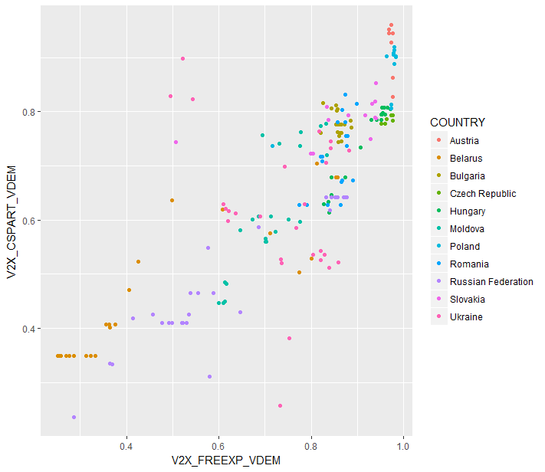
Example: freedom of expression (1)

Slide 10
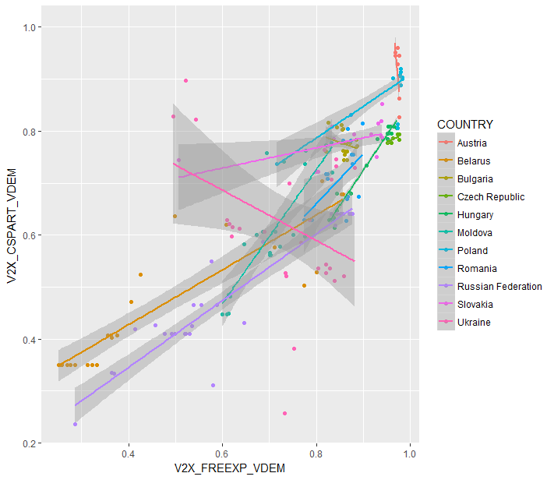
Example: freedom of expression (2)
Ukraine is exceptional (pink)

Slide 11
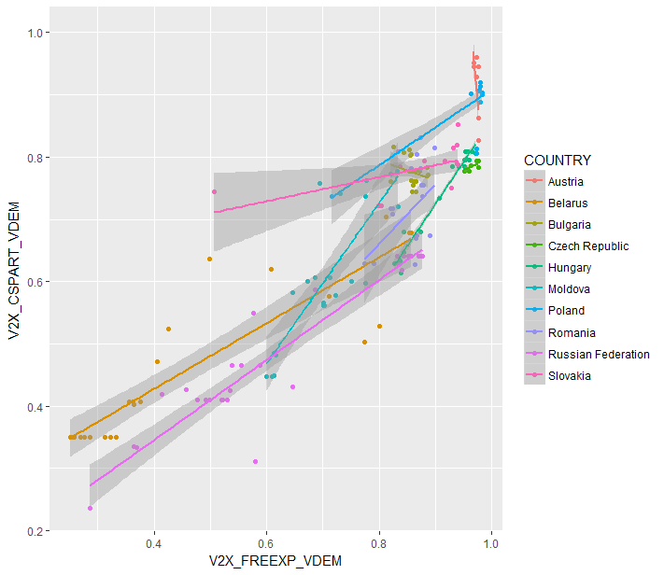
Example: freedom of expression (3)

Slide 12
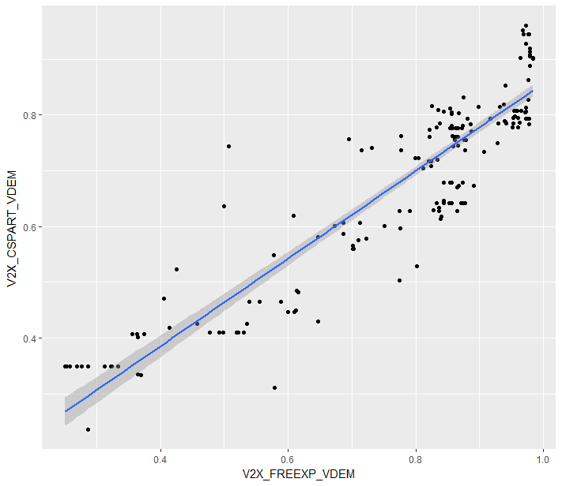
Example: freedom of expression (3)

Slide 13
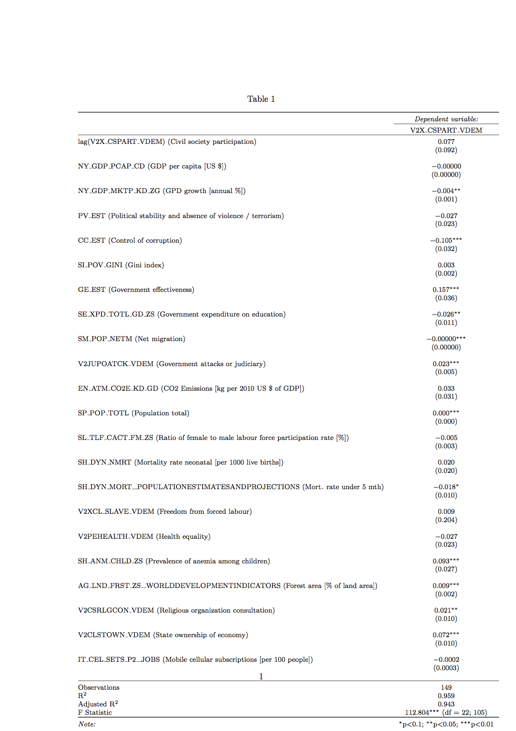
Final result

Slide 14
CEE mapping

Slide 15
Some relations – starting from health factors

Slide 16
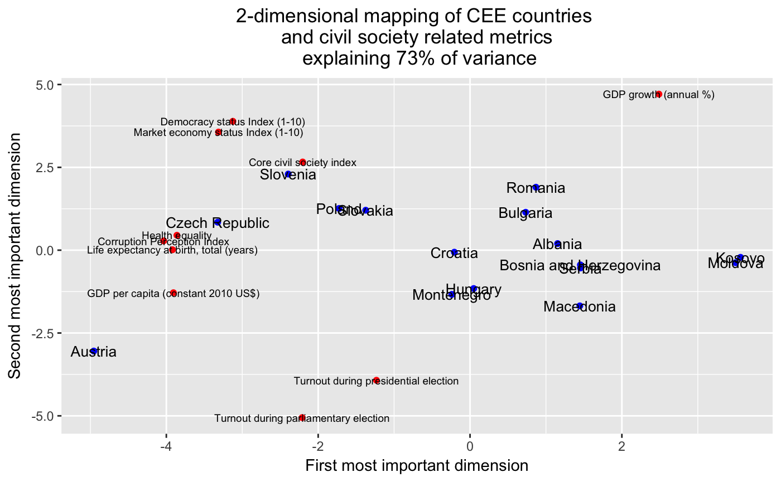
CEE 2017
GDP is very important and is different than GDP growth!!!
Austria is not included in Democracy and Market economy status

Slide 17
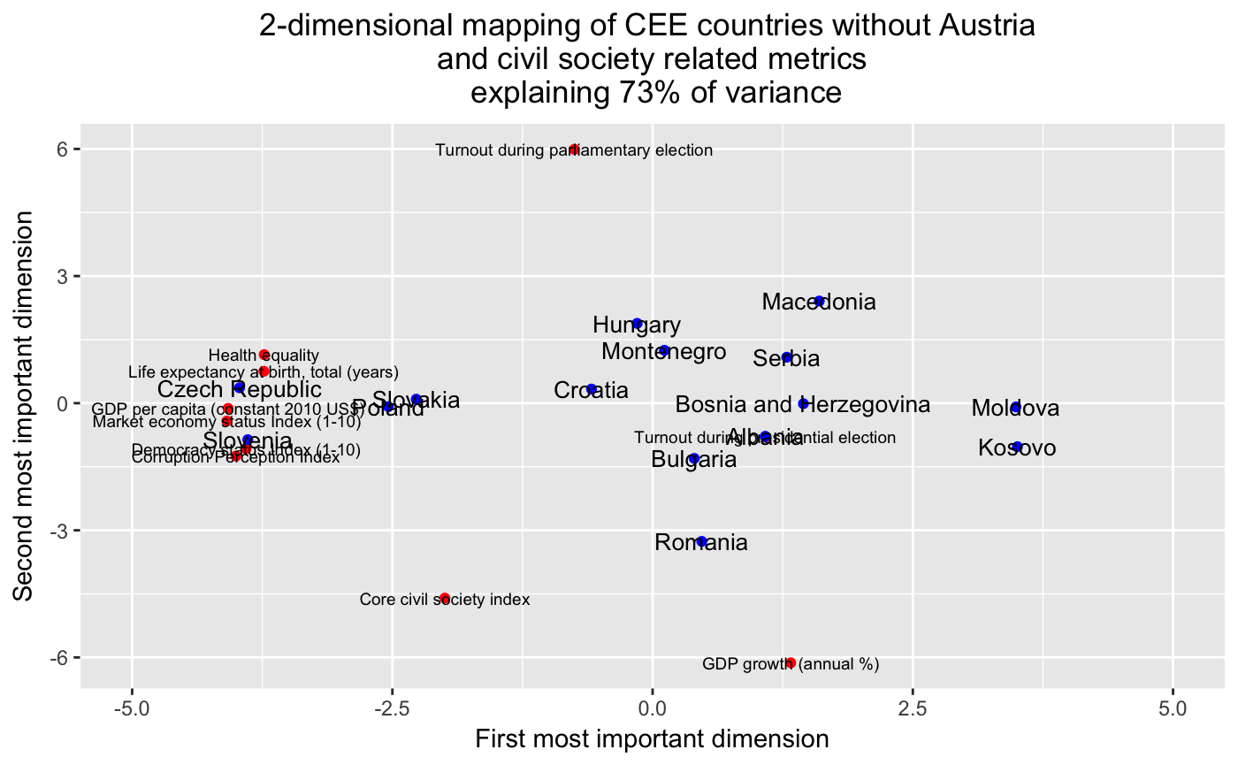
CEE 2017
Civil Society very close to GDP growth

Slide 18
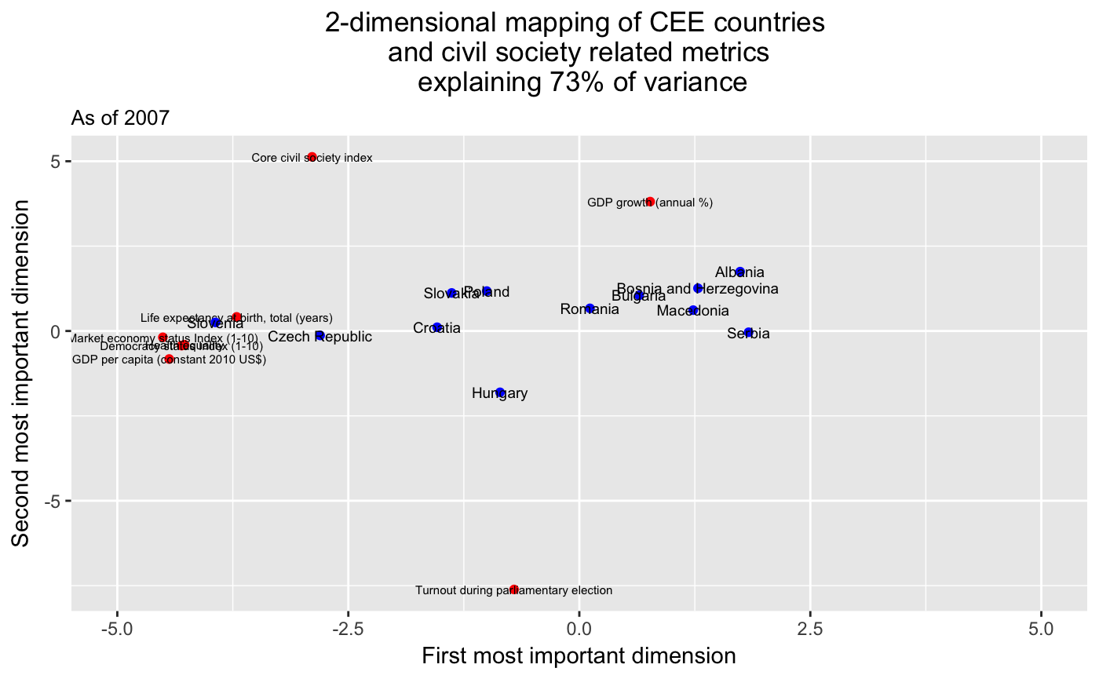
CEE 2017 – time series
A bit limited scope of variables

Slide 19
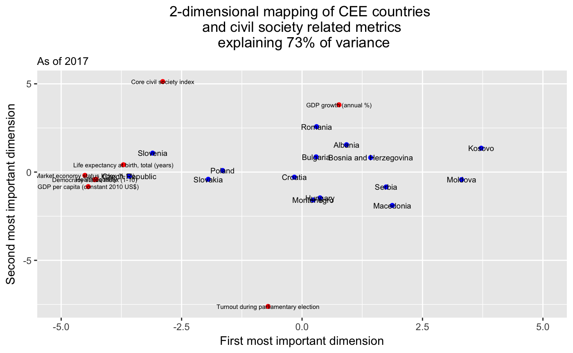
CEE 2017 – time series
Look at Croatia

Slide 20
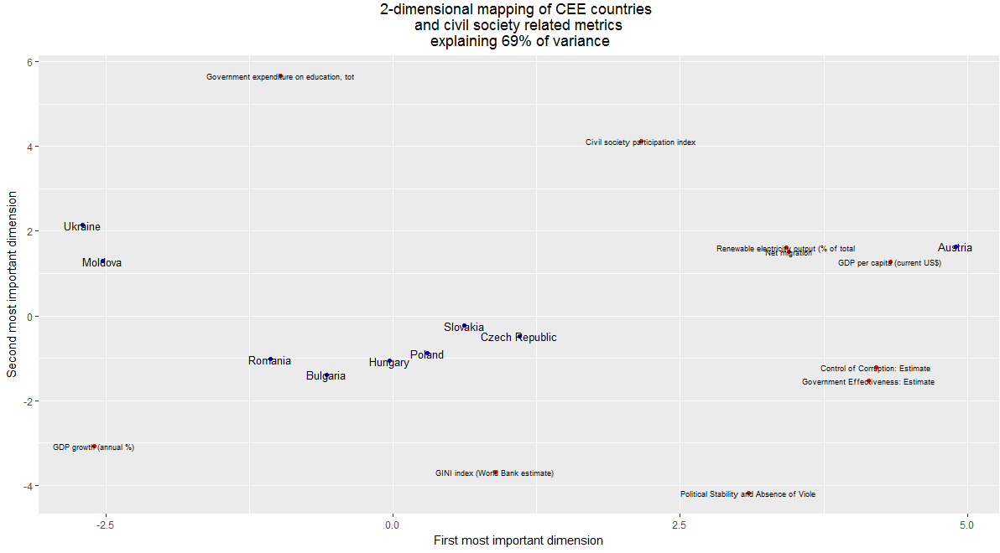
CEE – different approach

Slide 21
Health

Slide 22
Prediction of Health equality
Civil society participation is the most important!!!!

Slide 23
Prediction of Health equality
Positive correlation between Health Equality, GDP per capita, Corruption perception index , Democracy status index and Civil society participation index, all of these seem to be closely related to GDP
Particulary Civil society participation index has higher impact on Health equality in CEE countries compared to the rest of the world
Some non-findings: None or minimal effect of Paliametary elections turnout, Share of employed or GDP growth on health equality
Countries with lower Health equality have in general higher CSO anti-system movements

Slide 24
Prediction of Health equality
Positive correlation between Health Equality, GDP per capita, Corruption perception index , Democracy status index and Civil society participation index, all of these seem to be closely related to GDP
Particulary Civil society participation index has higher impact on Health equality in CEE countries compared to the rest of the world
Some non-findings: None or minimal effect of Paliametary elections turnout, Share of employed or GDP growth on health equality

Slide 25
Final notes

Slide 26
Suggestions for future research
More accurate exploratory and cleaning process of the data => “More data dominates better techniques”
Normalization of variables for better interpretation of coefficients
Possible models (an overview for future discussion)
- Random forest
Gain a better understanding of the complex matter of civil society by:
conducting case studies for countries that disclose exceptional behaviour in multiple dimensions (e.g. Ukraine)
using regional data and spatial analysis
implementing microeconomic data and/or behavioural approaches (e.g. from household surveys) to explain what drives/motivates people to engage in civil society

Slide 27
Data Sources
World Bank: Lin, Justin Y. 2012. New Structural Economics: A Framework for Rethinking Development and Policy. © World Bank. http://hdl.handle.net/123123123123/123 License: Creative Commons Attribution license (CC BY 3.0 IGO)
Bertelsmann Transformation Index: http://www.bti-project.org/en/data/
Varieties in Democracy: David Altman, Michael Bernhard, M. Steven Fish, Adam Glynn, Allen Hicken, Carl Henrik Knutsen, Joshua Krusell, Anna Lührmann, Kyle L. Marquardt, Kelly McMann, Valeriya Mechkova, Moa Olin, Pamela Paxton, Daniel Pemstein, Josefine Pernes, Constanza Sanhueza Petrarca, Johannes von Römer, Laura Saxer, Brigitte Seim, Rachel Sigman, Jeffrey Staton, Natalia Stepanova, and Steven Wilson. 2017. “V- Dem [Country-Year/Country-Date] Dataset v7.1” Varieties of Democracy (V-Dem) Project.
World Values Survey: WORLD VALUES SURVEY Wave 6 2010-2014 OFFICIAL AGGREGATE v.20150418. World Values Survey Association (www.worldvaluessurvey.org). Aggregate File Producer: Asep/JDS, Madrid SPAIN.
Red Cross Federation: http://data.ifrc.org/fdrs/data-download
Corruption Perception Index: CORRUPTION PERCEPTIONS INDEX (2017) by Transparency International is licensed under CC BY 4.0 DE
The International Institute for Democracy and Electoral Assistance: Reproduced by permission of International IDEA from VOTER TURNOUT DATABASE © International Institute for Democracy and Electoral Assistance [2018].

Slide 28

inspired by
Erste Hub / BeeOne / Group Brands

